Slide 1
CSS : Box Model

Slide 2
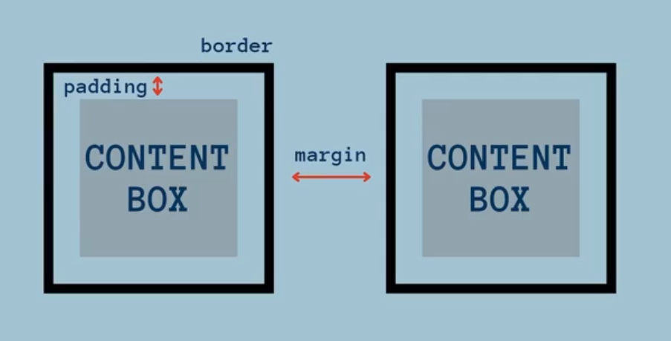

Slide 3
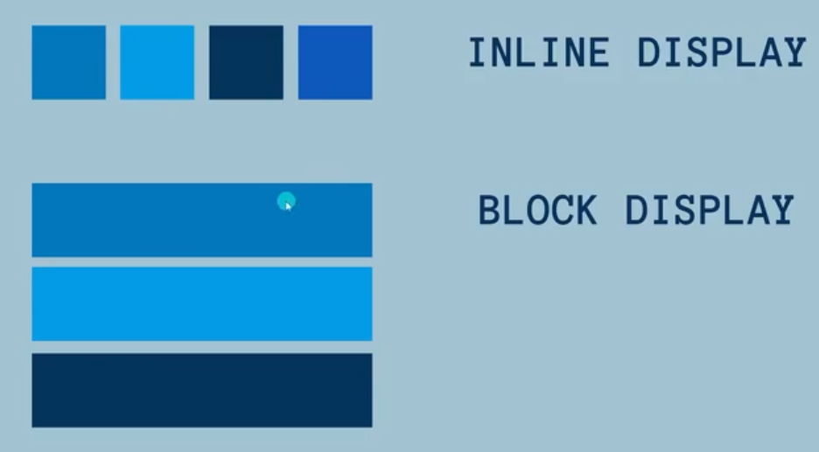
CSS : Box Model

